Slide 1
Ryan Meijer - 40481041
Quick Reference Guide

Slide 2
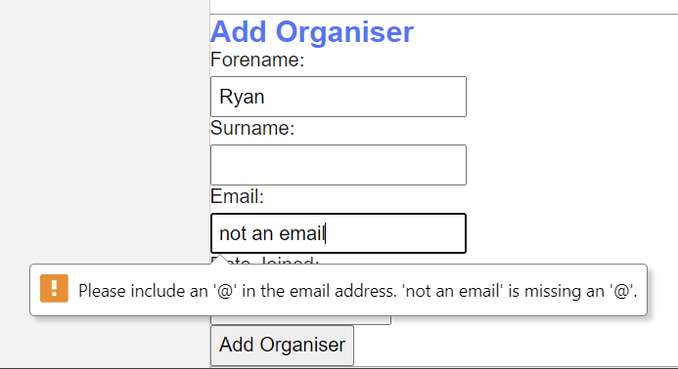
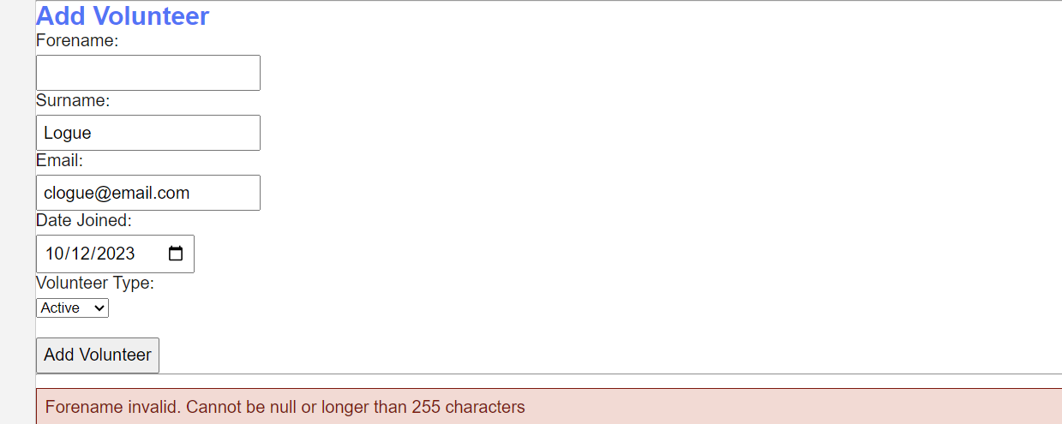
Validation
Client Side Validation
Found in js/myJs.js and implemented in CRUD-Organisers.html & CRUD-Volunteers.html
This prevents user inputs which are not compliant with database structure i.e. Null or which are not correctly formatted(valid email address)

Slide 3
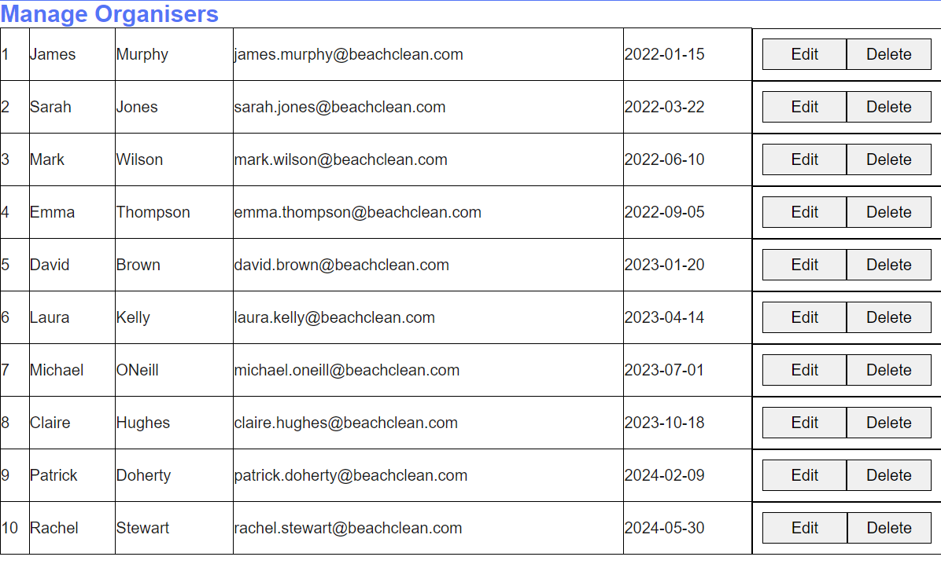
Retrieve
CRUD Web Interaction: Retrieve
Found in CRUD-Organisers.html, CRUD-Volunteers.html & Events.html
Properly display entries of the database

Slide 4
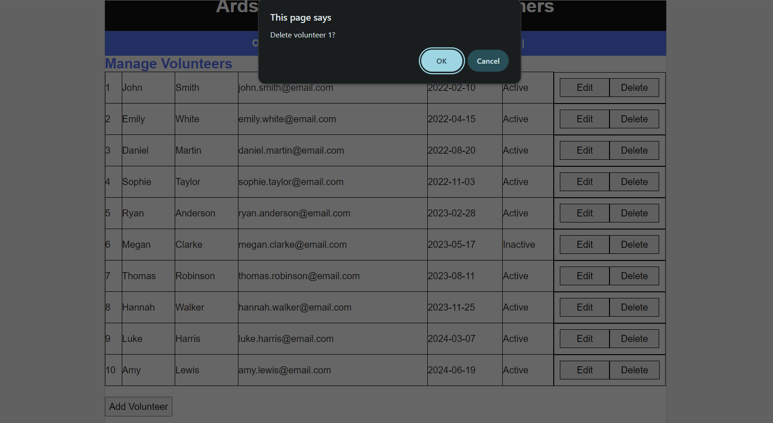
Delete
CRUD Web Interaction: Delete
Found in CRUD-Organisers.html & CRUD-Volunteers.html
Remove records from tables in the database. Confirmation popup shows up first

Slide 5
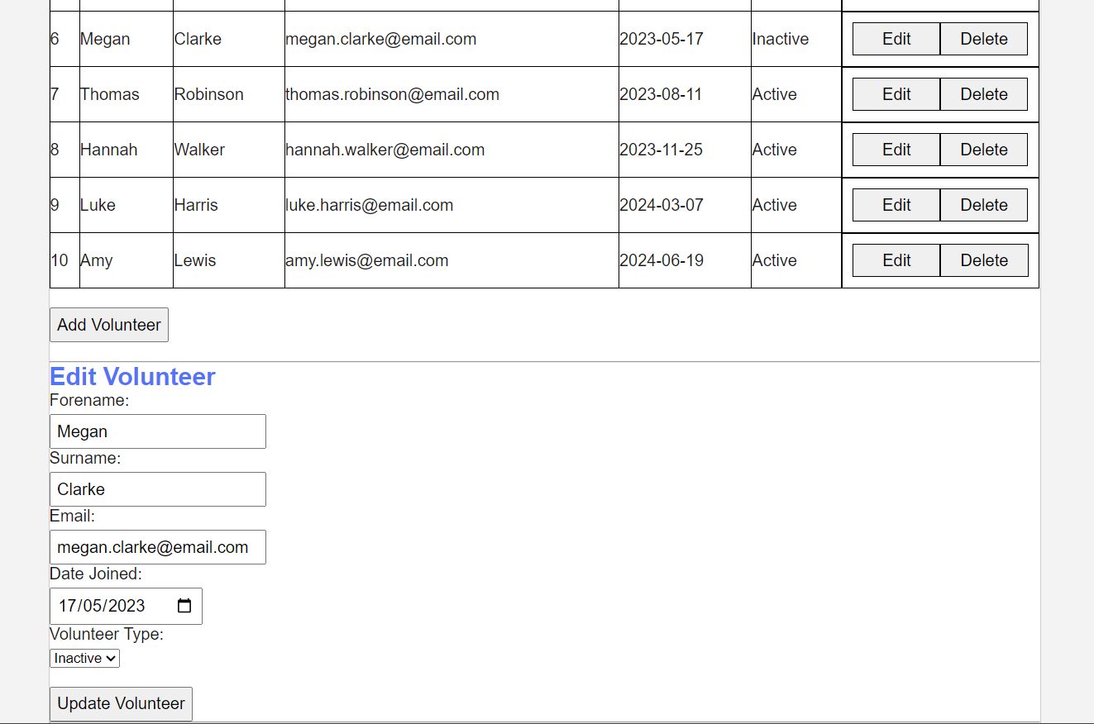
Update
CRUD Web Interactions: Update
Found in CRUD-Organisers.html & CRUD-Volunteers.html
Allow for the modification of records in tables of the database. Form is auto filled in when record is selected

Slide 6
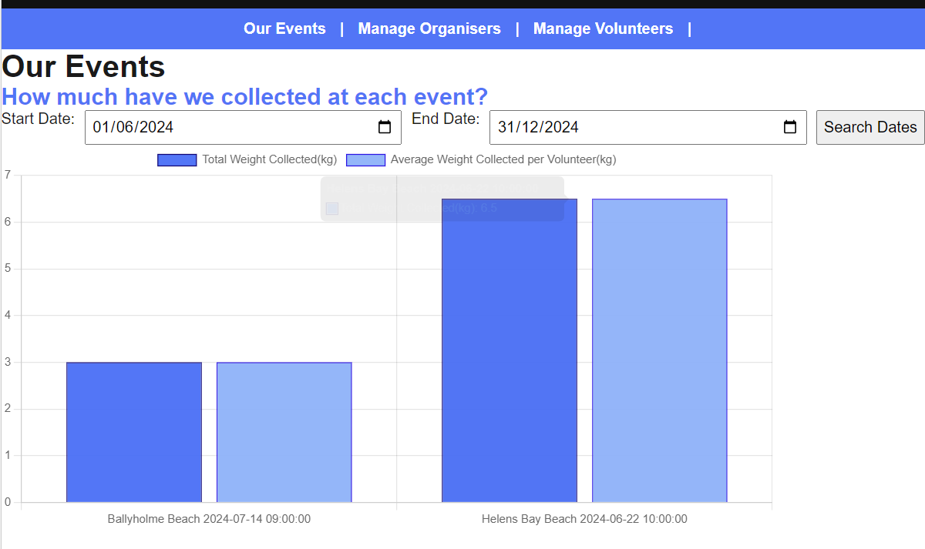
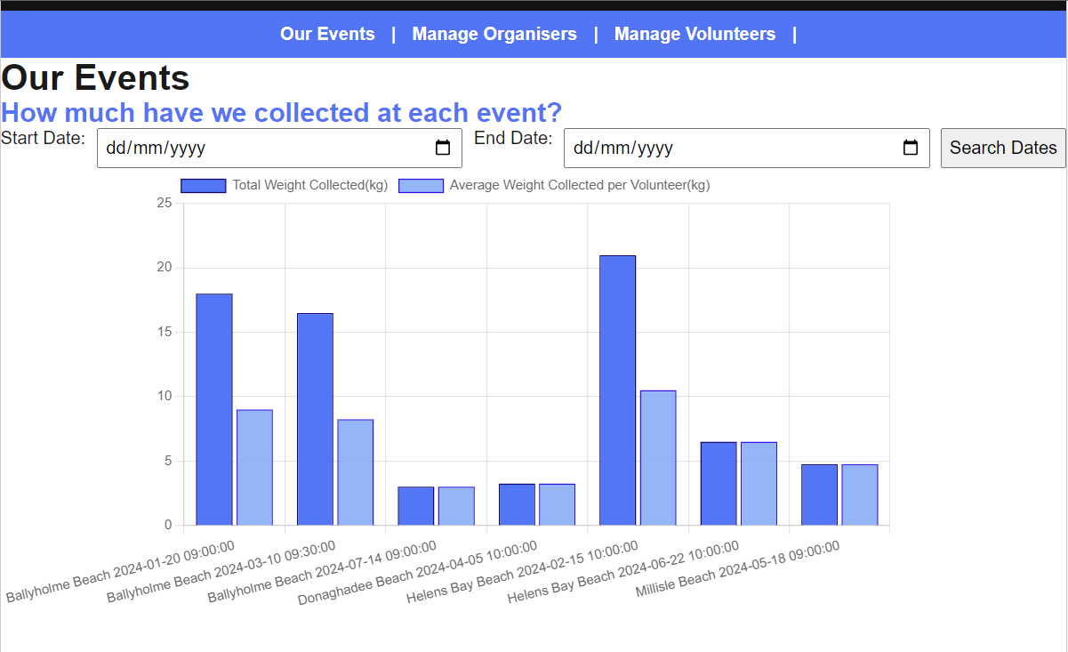
Parameterised Charting
Parameterised Chart
Found in Events.html
Retrieves filtered data based on user inputs of date range and outputs as a chart. By default will include all data

Slide 7
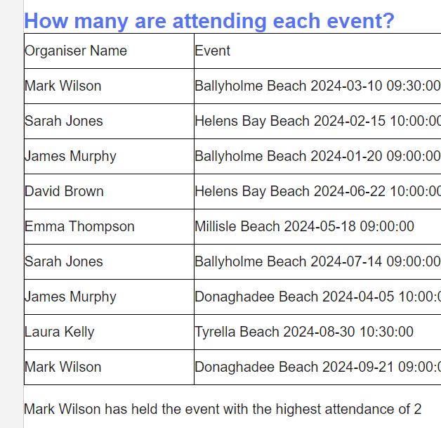
Dynamic Data Retrieval
Dynamic Data Retrieval
Found in Events.html
Retrieves live data from database and displays as a table and summary sentence

Slide 8
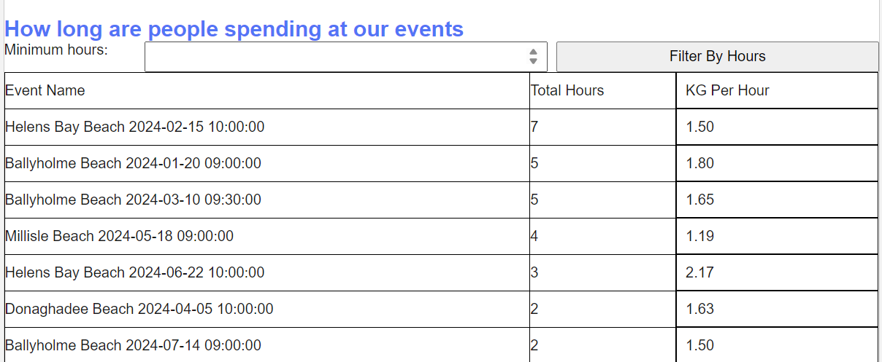
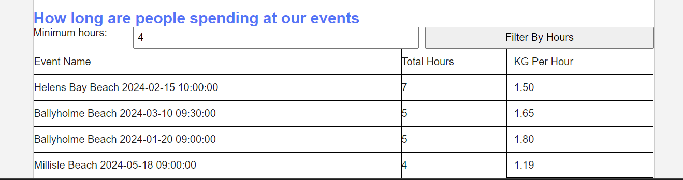
Parameterised Report
Parameterised Tabular Report
Found in Events.html
Retrieves filtered data based on user inputs of date range and outputs as a table. By default will include all data

Slide 9
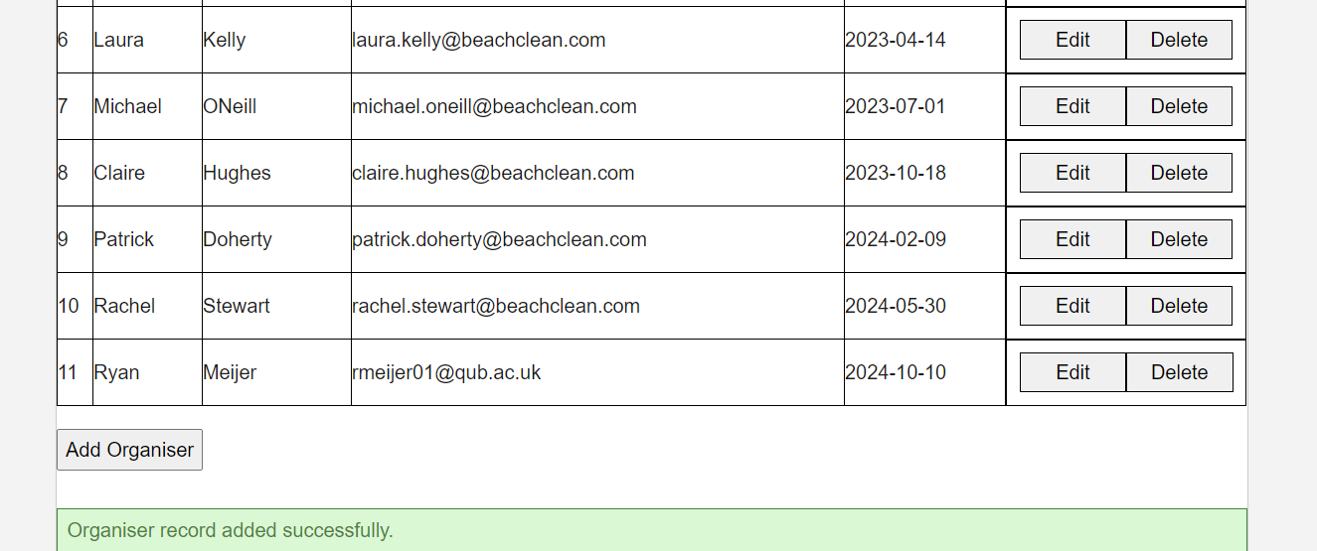
User Feedback
User Feedback / Confirmation
Found in CRUD-Organisers.html & CRUD-Volunteers.html
Assures user that commands have been completed successfully

